Slide 1

Network Security
Lee Tobin
lee.tobin@griffith.ie

Slide 2
12 weeks (subject to change)
Intro + risk management / policies
Identity / authentication
Authorisation & access control
Auditing and accountability
Crypto
Laws / privacy / compliance
Operations security: threat assessment / threats to the organisation
Threats / attacks / humans
Physical security: data centres, physical access control, monitoring
Network Security: IDS/firewall/wireless security
OS security overview: system hardening, windows patching
Application security / wrap up

Slide 3
Assessments
50% exam and 50% continuous assessment
End of module assignment
Graded assignment every second week (short Qs or MCQs)
2.5 hours per week autonomous learning​
Recommended reference texts will be in the library​

Slide 4
Reading...
Network Security Bible 2nd Edition,
Cole E., Wiley & Sons, 2009​
Practical Unix & Internet Security 3rd Edition,
Garfinkel S., Spafford G., Schwartz A., O Reilly, 2003

Slide 5
What is network security?
Network security can be considered part of Information Security (InfoSec)
Information Security - “protecting information and information systems from unauthorized access, use, disclosure, disruption, modification, or destruction”
-Committee on National Security Systems (US)
“well-informed sense of assurance that the information risks and controls are in balance.” —Jim Anderson, Inovant (2002)

Slide 6
The CIA Triad
Security model
Confidentiality
Integrity
Availability
Notes:
Keep things private, keep things for changing when they are not supposed to, allow us to access out things.

Slide 7
Confidentiality
Extension or component of privacy, subtle. (read up on this)
Privacy -> overall & Confidentiality -> information
Protects the data from unauthorised disclosure​
Ensures the necessary level of secrecy is enforced at each junction of data processing​
confidentiality usually implements encryption

Slide 8
Integrity​
Ensuring that the data is not modified.​
Must ensure accuracy and reliability of the information and Information Systems. ​
Must not allow unauthorized modification (intentional or accidental)​
“The trouble began Thursday morning, when Mizuho Securities tried to sell 610,000 shares at 1 yen (less than a penny) of a job recruiting firm called J-Com Co., which was having its public debut on the exchange.​”
It had actually intended to sell 1 share at 610,000 yen (€5,041).​​
http://www.msnbc.msn.com/id/10394551/ns/business-world_business/t/botched-stock-trade-costs-japan-firm-m/#.Tj350YKZhBk​
​
​
​

Slide 9
How to provide integrity?
Hashing, signing... more later

Slide 10
Availability
The ability to access data and systems by authorized parties​.
This is very easy to attack and hard to defend against.​
Attacks are often DoS type attacks.​
Example of Availability attack:​
Taking down a service (power grid, website etc.)
Interfering with stock market trades​
​

Slide 11
RAND R-609-1
Security Controls for Computer Systems - Technical Report
Safety of data​
Limiting unauthorized access to data​
Involvement of personnel from multiple levels of an organization​

Slide 12
Things progressed
Networks of computers became more common; so too did the need to interconnect networks​
Internet became first manifestation of a global network of networks​
In early Internet deployments, security was treated as a low priority

Slide 13
Security
“The quality or state of being secure - to be free from danger”
...we want to protect our stuff!
Physical security​
Personal security ​
Operations security ​
Communications security ​
Network security​
Information security​

Slide 14
The Parkerian hexad
- Donn Parker’s book “Fighting Computer Crime”
Confidentiality​
Integrity​
Availability​
Possession​ - physical disposition
Authenticity - proper attribution​
Utility​ - how useful
(The value of information comes from the characteristics it possesses)

Slide 15
Securing Components​
Computer can be subject of an attack and/or the object of an attack​
When the subject of an attack, computer is used as an active tool to conduct attack​
When the object of an attack, computer is the entity being attacked​
Notes:
It is important to note that the same computer can be both the subject and object of an attack, especially in multi-user systems.​

Slide 16
Security is a balance
Impossible to obtain perfect security; it is a process, not an absolute​
Security should be considered a balance between protection and availability​
To achieve balance, level of security must allow reasonable access, yet protect against threats​

Slide 17
Bottom-Up Approach
Grassroots effort: systems administrators attempt to improve security of their systems​
Key advantage: technical expertise of individual administrators​
Seldom works, as it lacks a number of critical features:​
Participant support ​
Organizational staying power​

Slide 18
Top-Down Approach​
Initiated by upper management​
Issue policy, procedures and processes​
Dictate goals and expected outcomes of project​
Determine accountability for each required action​

Slide 19
Policies

Slide 20
Policies?
Provide a framework for the ​management of security​ across the enterprise​
Some terms:
Policies​ - High level statements that provide guidance to workers who make decision​s
Standards​ - Statements that provide specific technical specifications​
Guidelines​ - Optional recommended specifications​

Slide 21
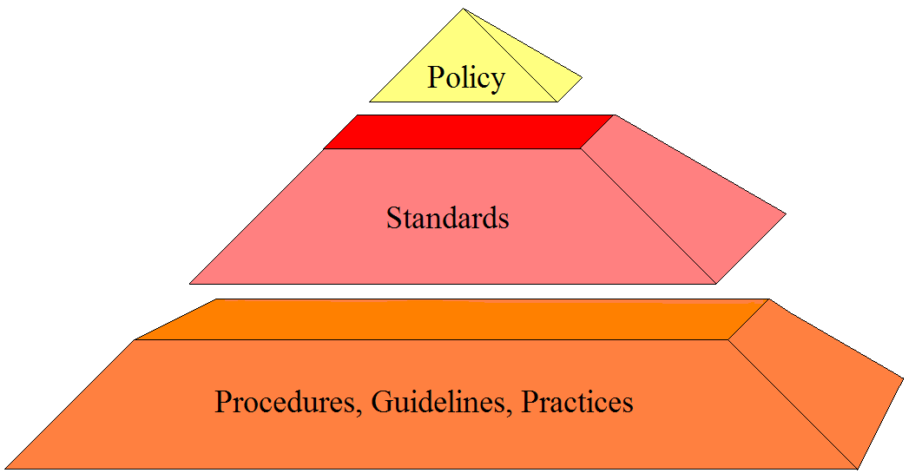
Security Policy
Access to network resource will be granted through a unique user ID and password
Passwords will be 8 characters long
Passwords should include one non-alpha and not found in dictionary

Slide 22
Elements of policies​
Set the tone of management​
Establish roles and responsibility​
Define asset classifications​
Provide direction for decisions​
Establish the scope of authority​
Provide a basis for guidelines and procedures​
Establish accountability​
Describe appropriate use of assets​
Establish relationships to legal requirements​

Slide 23
Policy Lifecycle
IS Goals
Corporate Goals
Policy
Standards
Procedures
Guidelines
Awareness
Actions
Info Security

Slide 24
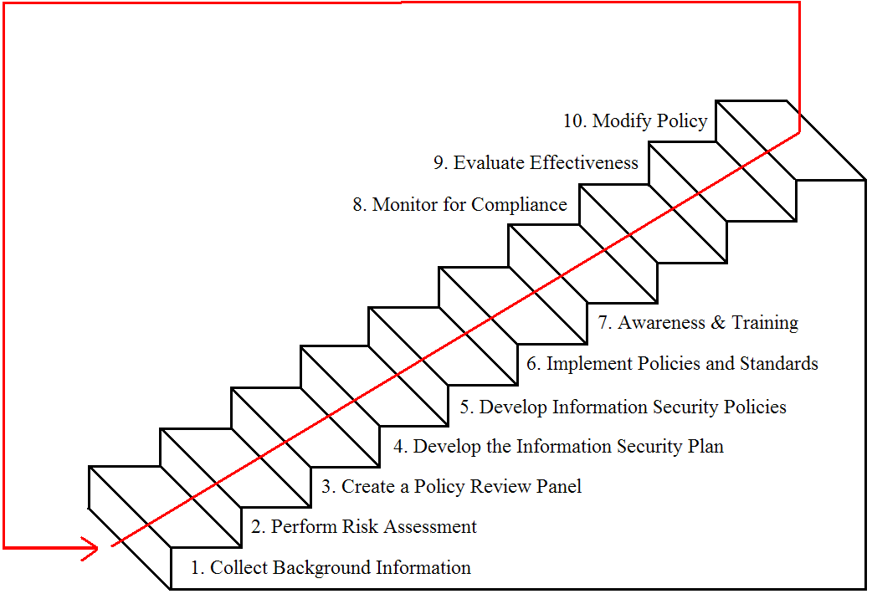
Ten steps to a good policy

Slide 25
Step 1 – Collect Background Information
Obtain existing policies
HIPAA (The Health Insurance Portability and Accountability Act of 1996)
27001:2013 (iso.org , IT – Infosec , ISMS, Requirements)
Identify what levels of control are needed
Identify who should write the policies

Slide 26
Step 2 – Perform Risk Assessment (larger task)
Justify the Policies with Risk Assessment
Identify the critical functions
Identify the critical processes
Identify the critical data
Assess the vulnerabilities

Slide 27
Information Risk Management (IT risk management) ​
IRM is the process of identifying and assessing risk and reducing it to an acceptable level
(again) There is no such thing as 100% security!
You must identify risks and mitigate them with either countermeasure or by transferring risk.​
Bottom line:
Risk is impossible to totally measure, but we must prioritize the risks and attempt to address them!​
​

Slide 28
What are risks​
Some types of risk​
Physical damage​
Human interaction (accidental or intentional action)​
Equipment malfunction ​
Inside and outside attacks​
Misuse of data​
Loss of data ​
Application error​s

Slide 29
Information risk management​
IRM is ultimately the responsibility of management
All organizations should have an IRM policy.​
The IRM policy should support the organization's mission.​
All organizations should have an IRM team.​
IRM should be a subset of the company’s total Risk Management Policy.​

Slide 30
Goal
​
​
​Goal of IRM is to ensure the company is protected in the most cost effective manner!​
​

Slide 31
Vulnerability​
A software, a hardware, or procedural weakness that may provide an attacker the opportunity to obtain unauthorized access.​
​
Examples?​
Could be an unpatched application​
Open modems
Lax physical security​
Weak network protocol​

Slide 32
Threat ​
A natural or man-made event that could have some type of negative impact on the organization. ​
​
A threat requires a vulnerability to create an impact​
​

Slide 33
Threat Agent ​
An actual person or entity that takes advantage of a vulnerability.​

Slide 34
Risk​
This likelihood of a threat agent taking advantage of a vulnerability and the corresponding business impact​
​
Risk ties the vulnerability, threat and likelihood of exploitation together.​

Slide 35
Exposure​
An instance of being exposed to losses from a threat agent. ​
​
Example: A public web server that has a known vulnerability that is not patched, is an exposure.​

Slide 36
Countermeasure or Safeguard​
Some control or countermeasure put into place to mitigate the potential risk. A countermeasure reduces the possibility that a threat agent will be able to exploit a vulnerability. ​
​
(again!) You can NEVER 100% safeguard something​

Slide 37
Security Controls​
You try to protect your company with controls/countermeasures/safeguards.
These “controls” usually fall into one of these categories​​:
Preventative​
Detective​
Corrective​
​
​

Slide 38
Security Controls​
Each category can have controls of different types​
Administrative controls – policies, standards, procedures, guidelines, personnel screening, training​
Technical controls (logical controls) - authentication, firewalls, biometrics etc.​
Physical controls – locks, monitoring, mantraps, environmental controls.​
​
​

Slide 39
Control matrix
Preventative
Detective
Corrective
Administrative
Background checks | Annual reviews | Terminations
Fences | Motion sensor | Security guards
Firewall | IDS | System restores
Physical
Technical

Slide 40
Controls: Functional vs. Assurance​
All controls must be evaluated by their functional and assurance requirements​
​Functional: ​
“Does the solution carry out the required tasks”​
Assurance: ​
“How sure are we of the level of protection this solution provides”​

Slide 41
Risk Analysis​
IRM team will need to analyze risk. But is risk analysis?​
A tool for risk management, which identifies assets, vulnerabilities and threats.​
Access possible damage and determine where to implement safeguards​
​

Slide 42
Risk Analysis Goals​
Identify assets and their values​
Identify vulnerabilities and threats​
Quantify the probability of damage and cost of damage​
Implement cost effective countermeasures!​
ULTIMATE GOAL is to be cost effective. ​

Slide 43
Value of information and assets?​
It is important to understand an assets value if you plan on doing risk analysis. So what is something worth?​
​
Note that value can be measured quantitatively ​and ​qualitatively​
​
​
​

Slide 44
Quantitative​
Quantitative analysis attempts to assign real values to all elements of the risk analysis process. Including​
Asset value​
Safeguards' costs​
Threat frequency​
Probability of incident​

Slide 45
Quantitative Analysis​
Purely quantitative risk analysis is impossible as there are always unknown values, and there are always “qualitative” values. ​
You can automate quantitative analysis with software and tools. These require tons of data to be collected though, as such require time and effort to complete.​

Slide 46
Steps in quantitative analysis
Assign value to an asset​
Estimate potential loss for each asset and threat combination. (see SLE later)​
Perform a threat analysis – determine the probability of each threat occurring.​
Derive the Overall loss potential per threat per year.​
Reduce, Transfer, Avoid or Accept the Risk.​
​
​

Slide 47
Quantitative analysis: Assign value to assets​
What is something worth?​
Cost to obtain​
Money an asset brings in​
Value to competitors​
Cost to re-create​
Legal liabilities ​
etc…​
​
At the end of step one we must be able to assign a value to each asset.​
​

Slide 48
Quantitative analysis: Assign value to assets​
For each asset/vulnerability combination we need how much an instance of damage would cost us.​
Physical damage​
Loss of productivity​
Cost of repairing​
​
The expected percentage of damage of the total asset value is called the Exposure Factor (EF)​
​
​
​

Slide 49
Quantitative analysis: Estimate Loss Potential​
The expected percentage of damage of the total asset value is called the Exposure Factor (EF)​
​
Example:​
If you have a warehouse with €1,000,000 of value, and the threat is a fires, your fire suppression systems might stop a fire at 25%, this is your EF.​
​
​

Slide 50
Quantitative analysis: Estimate Loss Potential ​
Once we have the EF we use it to determine the Single Loss Expectancy (SLE) of an incident.​
​
SLE = asset value * EF​
Notes:
Exposure Factor (EF)​

Slide 51
Quantitative analysis: Estimate Loss Potential ​
In the warehouse / fire example​
​
SLE = asset value * EF​
asset value was €1,000,000​
EF was 25% (.25)​
​
SLE = €1,000,000 * .25 ​
SLE = €250,000​
​
​
Notes:
Exposure Factor (EF)​

Slide 52
Quantitative analysis: Perform a Threat Analysis​
Figure out the likelihood of an incident.​
Analyze vulnerabilities and rate of exploits.​
Analyze probabilities of natural disasters to your location​
Review old records of incidents.​
​In this step we need to calculate the Annualized Rate of Occurrence (ARO)​
Example: chance of a fire in any month = 10% then the ARO = .10 * 12 (1 year) So we can expect an ARO = 1.2 ​
Notes:
Annualized Rate of Occurrence (ARO)

Slide 53
Quantitative analysis: Derive the ALE​
Derive the Annual Loss Expectancy​ (ALE)
ALE = SLE * ARO​
​Example: ​
The ALE for the warehouse fire is​ ALE = SLE * ARO​
SLE = €250,000​
ARO = 1.2​
ALE = €250,000 * 1.2​ = €300,000​
​
Notes:
Annualized Rate of Occurrence (ARO) Single Loss Expectancy (SLE)

Slide 54
Quantitative analysis: Reduce, Transfer, Avoid or Accept the Risk ​
For each risk you can do the following​
Reduce risk ​(Install countermeasures to reduce ARO or EF​)
Transfer Risk​
Accept Risk​
Avoid Risk​
​

Slide 55
Determining Cost Effective Countermeasures​
​
​
​When determining whether to implement an countermeasure, you MUST be concerned about being cost effective.​
​

Slide 56
Determining Cost Effective Countermeasures​
Compute the ALE without the countermeasure in question​
Compute ALE2 which is the ALE after installing the countermeasure​
Add the cost of the countermeasure to ALE2​
Compare ALE to ALE2​
If ALE > ALE2 then the countermeasure is cost effective​
​

Slide 57
Problem
The probability of a virus infection per month is 50%.​
If an outbreak occurred your sales staff of 5, would not be able to work for the 4 hours while the systems were rebuilt. Each sales person makes €40/hour. ​
IT would require 1 person 4 hours to repair at a cost of €50/hour.​
A certain antivirus system could stop ALL viruses (ok, that’s just to make the math easier) but the cost is 20K per year for this system.​
​Questions:​
Should you implement the Anti-virus system?​
If so how much are you saving?​
If not how much are you wasting by buying it? ​​

Slide 58
Answer
Step 1: Determine SLE​
(5 sales * 4 hours each * €40) + (1 IT * 4 hours * 50) = €1000 cost per incident​
Step 2: Determine ARO​
ARO = 12 months * 0.5 likelihood per month = 6​
Step 3: Determine ALE​
ALE = SLE (€1000) * ARO (6) = ​€6000.00
​
Notes:
Single Loss Expectancy (SLE)

Slide 59
Answer ...
ALE without countermeasure was determined to be €6000​
​Compute ALE2​
ALE2 (ALE after countermeasure) = €0.00 ​
Countermeasure cost = €20,000​
ALE2 = €20,000​
So, ​ALE (€6,000) or ALE2 (€20,000)?
In this case it is NOT cost effective to implement the countermeasure.​
​
​

Slide 60
Details of Reducing Risk​
If the cost per year of the countermeasure is more than the ALE, don’t implement it, instead either:​
Transfer the risk​
Avoid the risk​
Accept the risk​
​

Slide 61
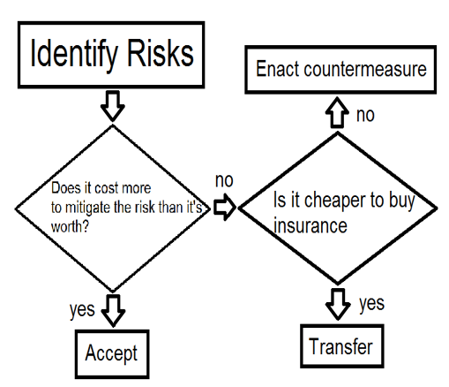
Risk Analysis Flowchart​

Slide 62
This slide is intentionally left blank

Slide 63
Step 3 – Create a Policy Review Board
The Policy Development Process
Write the initial “draft”
Send to the review board for comments
Incorporate comments
Resolve issues face-to-face
Submit “draft” policy for approval

Slide 64
Step 4 – Develop the Information Security Plan
Establish goals
Define roles
Define responsibilities
Notify the user community as to the direction
Establish a basis for compliance, risk assessment, and audit of information security

Slide 65
Step 5 – Develop Information Security Policies, Standards, and Guidelines
Policies
High level statements that provide guidance to workers who must make present and future decision
Standards
Requirement statements that provide specific technical specifications
Guidelines
Optional but recommended specifications

Slide 66
Policies, Standards, Baselines, Guidelines, and Procedures​
A security program must have all the pieces necessary to provide overall protection to a company and lay out a long term strategy. Policies, Standards, Baselines, Guidelines and Procedures are part of the security program​
​

Slide 67
Security Policy​
An overall GENERAL statement provided by senior management. ​
Very generic​
Provides “missions statement for security”​
Should represent business objectives​
Should be easily understood​
It should be developed to integrate security into ALL business functions and processes​

Slide 68
Security Policy​
It should be reviewed and modified as the company changes.​
Policy should be dated and version controlled.​
It should be forward thinking​
It should use strong language (MUST, not should)​
Should be non-technical​
​

Slide 69
Security Policy​
Can be one of four types:​
Regulatory – ensures an organization is following required regulations (finance, health)​
Advisory – strongly advises employees as to which types of behaviors should/should not take place​
Informative – informs employees of goals and missions relevant to a company, not specific or enforceable​
Directive​

Slide 70
System Specific Security Policy​
An organization security policy needs to be technology and solution independent.. it outlines the goals and missions.. NOT specific ways of accomplishing them.​
​
A systems specific policy represents the management's decision on SPECIFIC technologies and situations. These outline for example password policies or data encryption policies. These system specific policies are the structure that provides the support for the organizational security policy.​
​

Slide 71
Standards​
Standards are MANDATORY actions or rules. ​
Defines compulsory rules. ​
Standards give a policy it’s support and start adding specifics. ​
​
Example: ​
A standard is “all employees MUST wear their company ID badge at all times”​
​

Slide 72
Baselines​
Baselines – the process of establishing a minimum set of protections for a computer system/network in order to protect it attack from the hordes of script-kiddies and crackers.​
MINIMUM set of protections and configurations​
Example: a baseline may require that a system be compliant to some external measurement. Any systems must meet these requirements, changes to the system must be assessed to ensure the baseline is still being met.​
​
​
​

Slide 73
Baseline​
A baseline may also be a technical definition or configuration of a system. ​
​
Examples: ​
a baseline my specify that all windows XP systems must have SP2 installed, and ISS turned off.​
a baseline may also specify all Linux systems run SElinux in enforcing mode.​
​

Slide 74
Guidelines​
Guidelines are RECOMMENDED actions. ​
These cover the gray areas and are approaches to provide flexibility for unforeseen things. ​
The are not specific rules, but best practices.​
​
Examples?​
​

Slide 75
Procedures​
Detailed step-by-step tasks that should be performed in some situation.​
Lowest level In the policy as they are closest to users and resources.​
Procedures spell out how policy, standards and guidelines will be implemented for a specific resources (OS for example)​
Example:​
Written procedures on OS installation and configuration.​
​

Slide 76
Step 6 – Implement Policies and Standards​
Distribute Policies.​
Obtain agreement with policies before accessing Systems. (Acceptable Use Policies)​
Implement controls to meet or enforce policies.​

Slide 77
Step 7 – Awareness and Training​
Makes users aware of the expected behavior​
Teaches users how & when to secure information​
Reduces losses & theft​
Reduces the need for enforcement​
​

Slide 78
Step 8 – Monitor for Compliance​
Management is responsible for establishing controls​
Management should REGULARLY review the status of controls​
Enforce “User Contracts” (Code of Conduct)​
Establish effective authorization approval​
Establish an internal review process​
Internal Audit Reviews​

Slide 79
Pay your Dues….​
Due Diligence: act of investigating and understanding a risk a company faces.​
Due Care: demonstrates that a company has taken responsibility for its activities and has taken necessary steps to protect its assets and employees from threats.​
Not practicing these can lead to charges of negligence.​

Slide 80
Step 9 – Evaluate Policy Effectiveness​
Evaluate​
Document​
Report​
​

Slide 81
Step 10 – Modify the Policy​
Policies must be modified due to:​
New Technology​
New Threats​
New or changed goals​
Organizational changes​
Changes in the Law​
Ineffectiveness of the existing Policy​

Slide 82
DONE
lee.tobin@griffith.ie

